Slide 1
ASPEN Staged Separation Unit-Ops Samaa Zaman, Lane Crofton, Elina Tabarzadi, Tran Do and Michael Schachter
CHBE446: Design 2
5 February 2024

Slide 2
Introduction: Stage Separation Unit-Ops
Industrial Uses:
Purify desired components
Removing impurities and pollutants
Major unit-ops include:
Distillation Columns
Absorption Columns
Stripping Columns
Notes:
s

Slide 3
Relevance to Ammonia Synthesis
Undesirable pollutants produced
Primarily CO₂
Removed via separation techniques prior to reactor to prevent catalyst poisoning
The removal of carbon dioxide is commonly performed using a combination of absorption and stripping columns

Slide 4
Carbon Dioxide Removal Techniques
Carbon dioxide can be removed via both physical and chemical absorption/stripping
Industrially, chemical methods have been preferred
Leads to minimize waste of hydrogen
Common solvents used in the chemical absorption/stripping process include:
Monoethanolamine (MEA)
Potassium Carbonate (K₂CO₃)

Slide 5
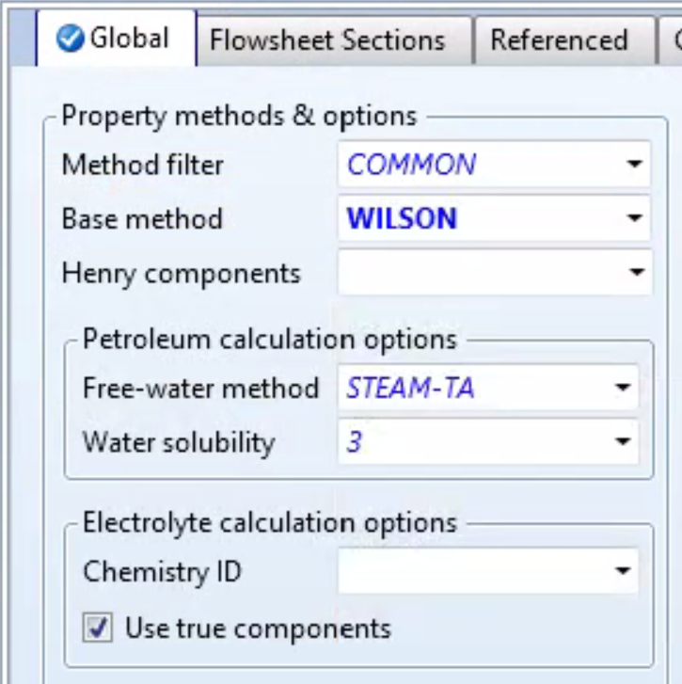
ASPEN Physical Absorption Column: Basic Setup
Step 1: Begin new ASPEN simulation
Step 2: Add all components from process
Step 3: Choose a property base method that best fits your components
Ex. Wilson which utilizes Henry’s Law

Slide 6
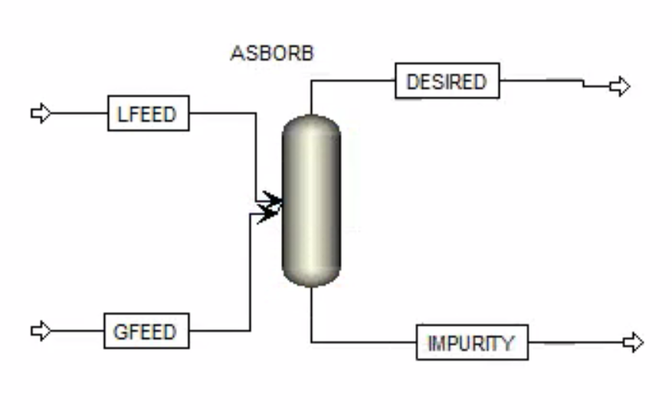
ASPEN Physical Absorption Column: Simulation Setup
Step 1: Add RADFRAC column to flowsheet
Step 2: Add 2 inlet streams to RADFRAC column
Can be useful to label as liquid and gas feed
Step 3: Add both a distillate and bottoms stream
For absorption the “distillate” is the desired vapor product with impurities removed

Slide 7
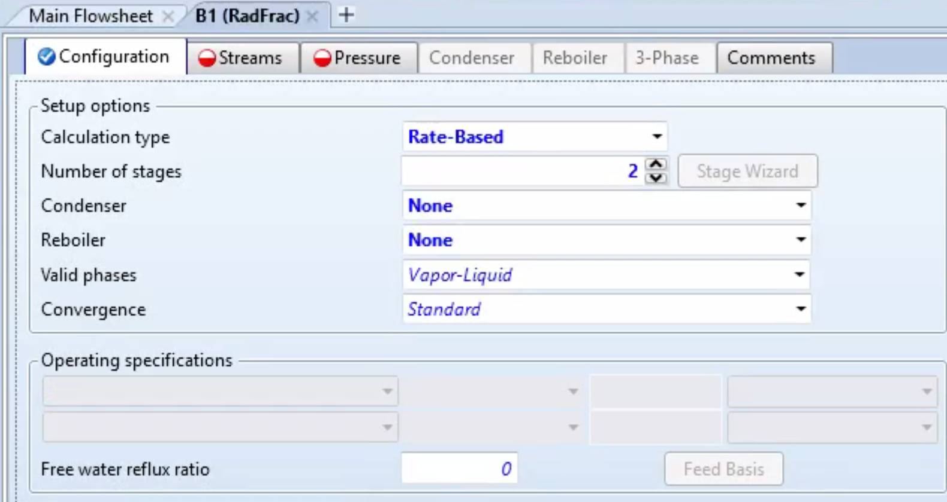
ASPEN Physical Absorption Column: RADFRAC Setup (1)
Step 1: Define properties of both inlet streams based upon process information
Includes flow rates, composition, temperature, pressure, etc.
Step 2: Under the configuration tab for the column, choose the following options

Slide 8
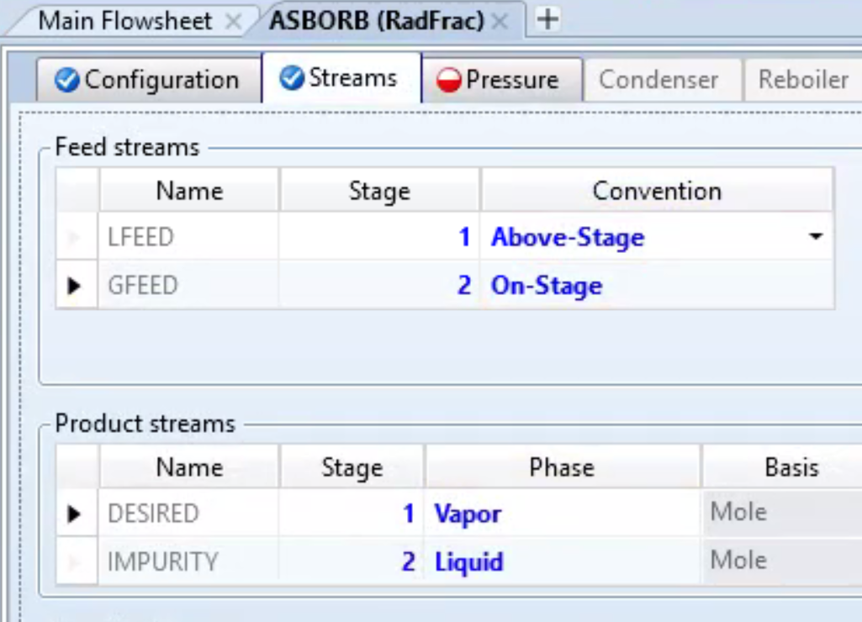
ASPEN Physical Absorption Column: RADFRAC Setup (2)
Step 1: Under the streams tab for the column, choose the following options
Liquid feed should enter at the top of the column
Gas feed should enter at the bottom

Slide 9
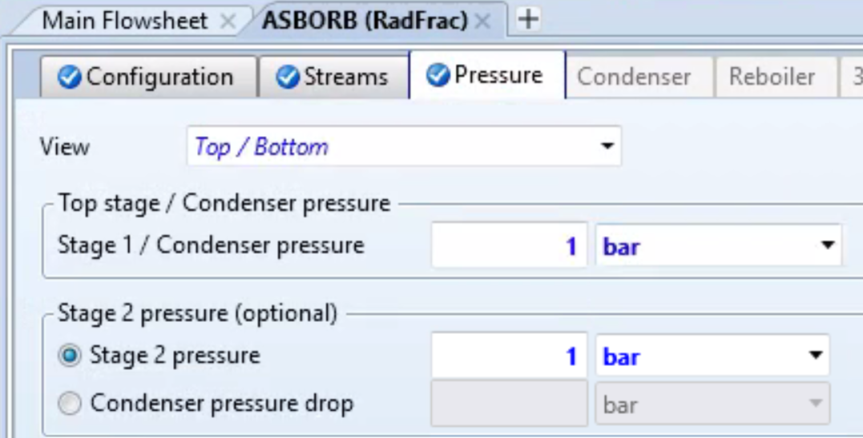
ASPEN Physical Absorption Column: RADFRAC Setup (3)
Step 1: Under the pressure tab for the column, enter the operating pressures for both stages
This will depend on the process being used
Ex. operating close to atmospheric pressure

Slide 10
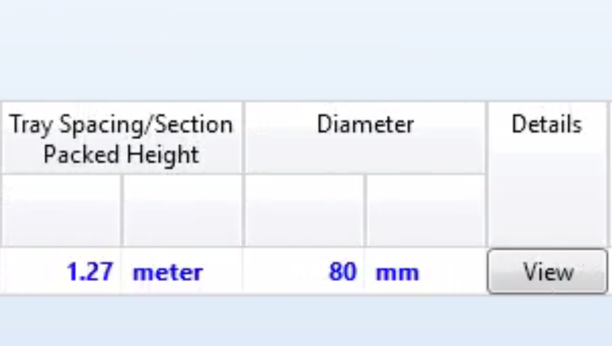
ASPEN Physical Absorption Column: RADFRAC Setup (4)
Step 1: On the side panel navigate to Blocks -> Your RADFRAC Column -> Column Internals
Step 2: Select Add New and double click on the new internals
Step 3: Scroll to the right and select the view option

Slide 11
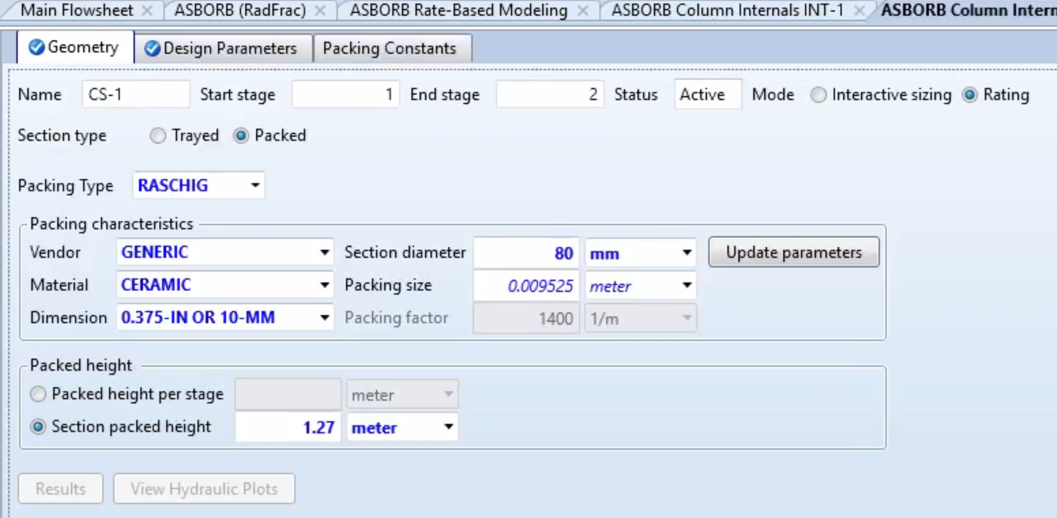
ASPEN Physical Absorption Column: RADFRAC Setup (5)
Step 1: Fill out the following screen based upon the specifications of your desired packing materials
Make sure that the rating option is selected, otherwise you will have incomplete errors

Slide 12
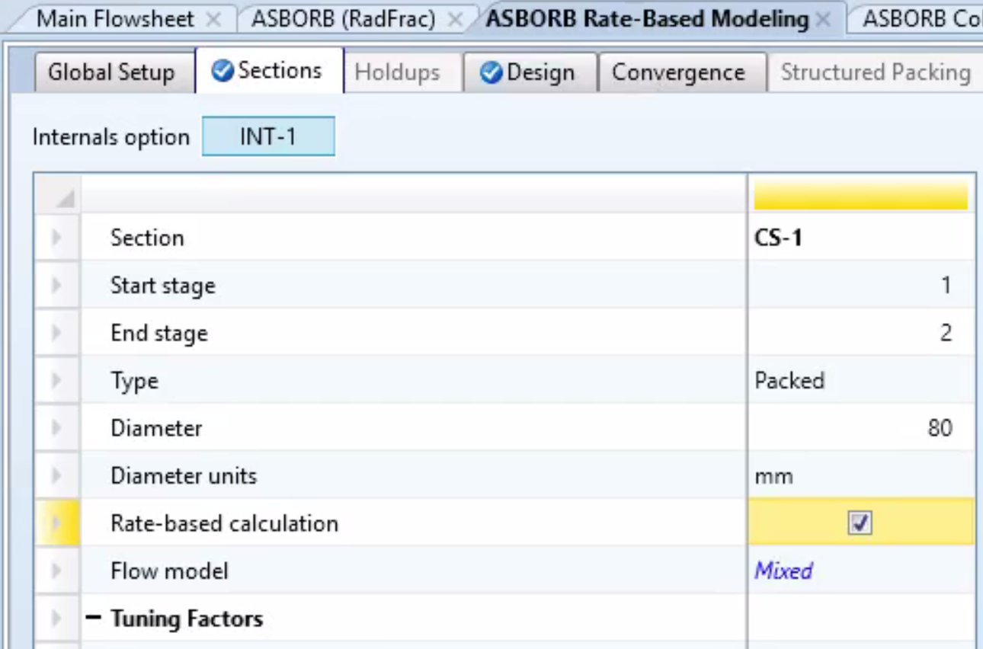
ASPEN Physical Absorption Column: RADFRAC Setup (6)
Step 1: On the side panel navigate to Blocks -> Your RADFRAC Column -> Rate-Based Modeling
Step 2: Check the box for Rate-based calculation
Step 3: Run your simulation!

Slide 13
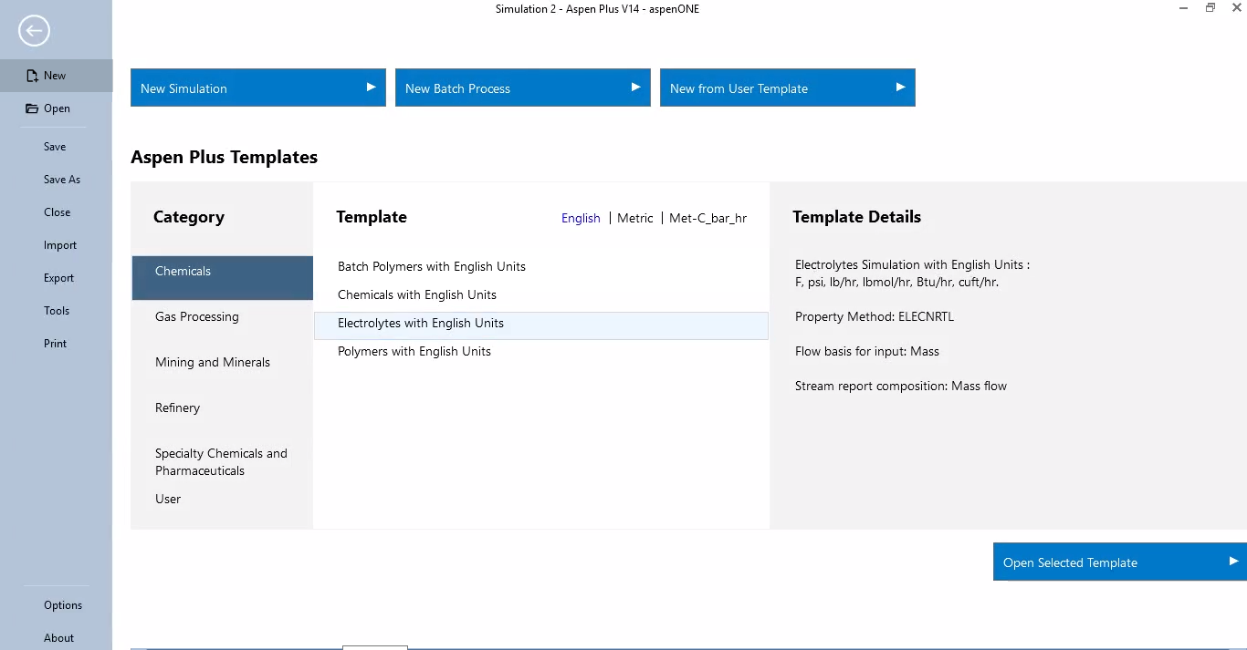
ASPEN Chemical Absorption Column: RADFRAC Setup (1)
Choose the Electrolytes Template

Slide 14
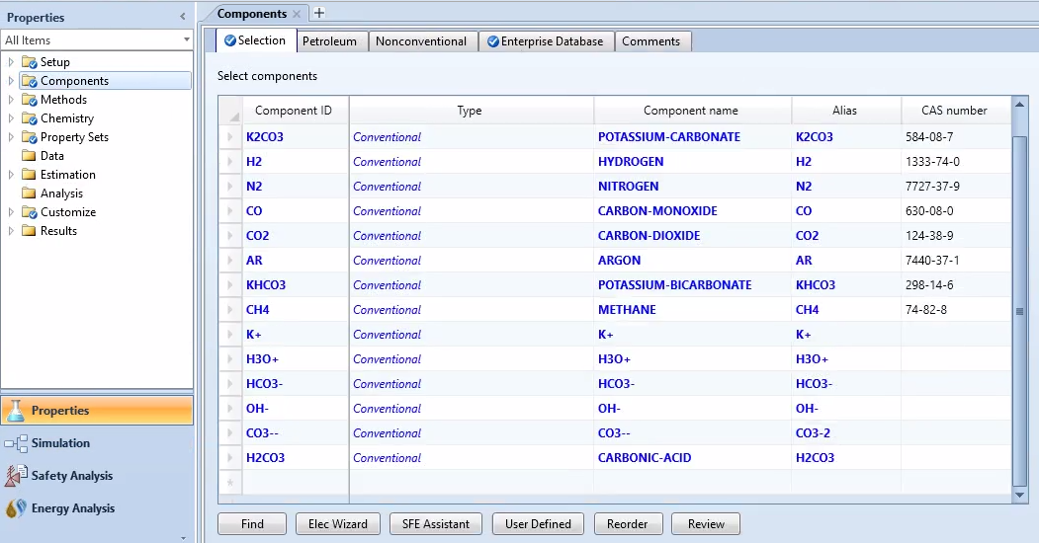
ASPEN Chemical Absorption Column: RADFRAC Setup (2)
Step 1: Under Properties, components; Input the required components for the process.
Step 2: Choose the Elec Wizard option to define the ionic species and salts that can be generated from the base components.

Slide 15
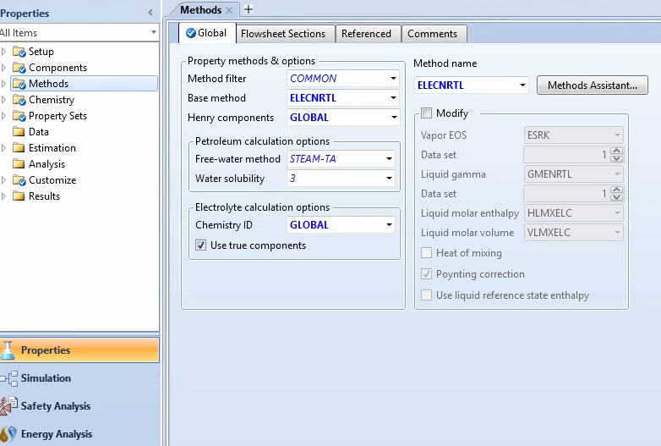
ASPEN Chemical Absorption Column: RADFRAC Setup (2)
Step 1: Under Methods, choose ELECNRTL, which is electrolyte NRTL model with Redlich-Kwong EOS.

Slide 16
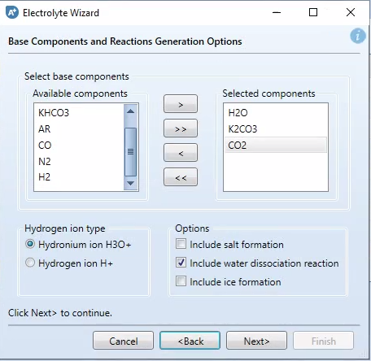
ASPEN Chemical Absorption Column: RADFRAC Setup (3)
Step 1: Select the base components for electrolyte chemistry generation.
Step 2: Select Hydrogen ion type.
Step 3: Include salt formation and water dissociation reaction.

Slide 17
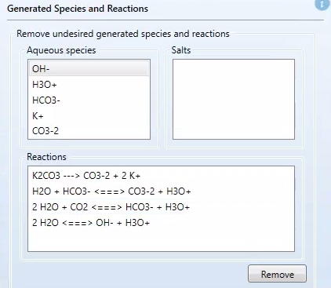
ASPEN Chemical Absorption Column: RADFRAC Setup (4)
Step 1: Remove not relevant generated
Species and their reactions

Slide 18
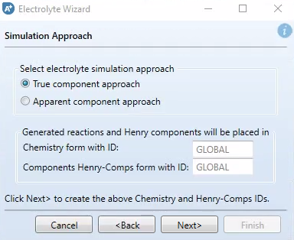
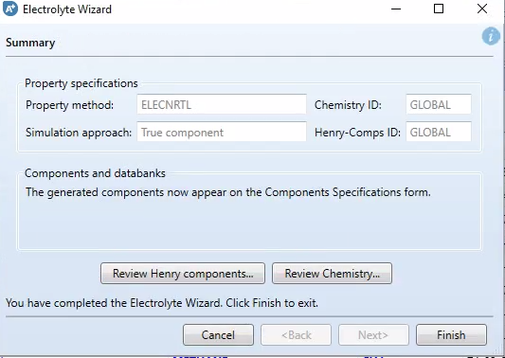
ASPEN Chemical Absorption Column: RADFRAC Setup (5)

Slide 19
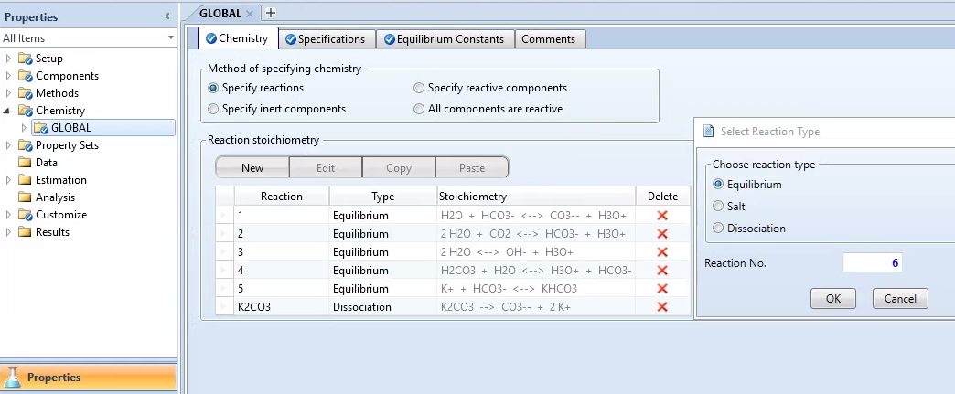
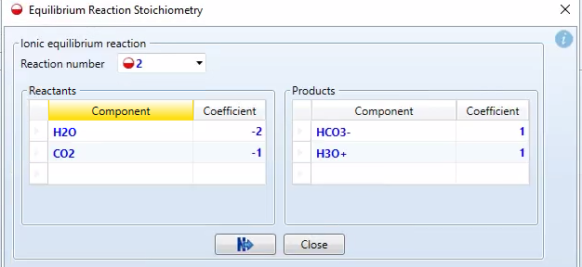
ASPEN Chemical Absorption Column: RADFRAC Setup (6)
Step 1: Under Chemistry, Global; Verify the reactions from Elec Wizard.
Step 2: Add any additional reaction with New button.
Step 3: Choose reaction type, and insert component and coefficient.

Slide 20
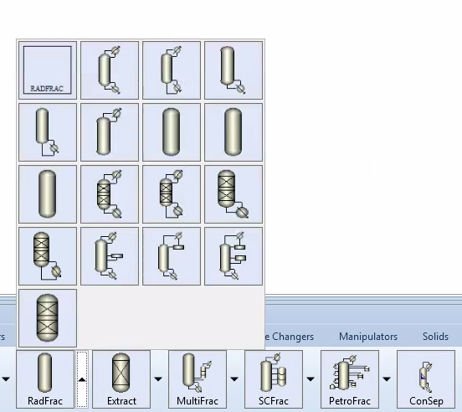
ASPEN Chemical Absorption Column: RADFRAC Setup (7)
Step 1: Build the process flow diagram using the Radfrac ABS unit model.
Step 2: Specify the process inlet streams.

Slide 21
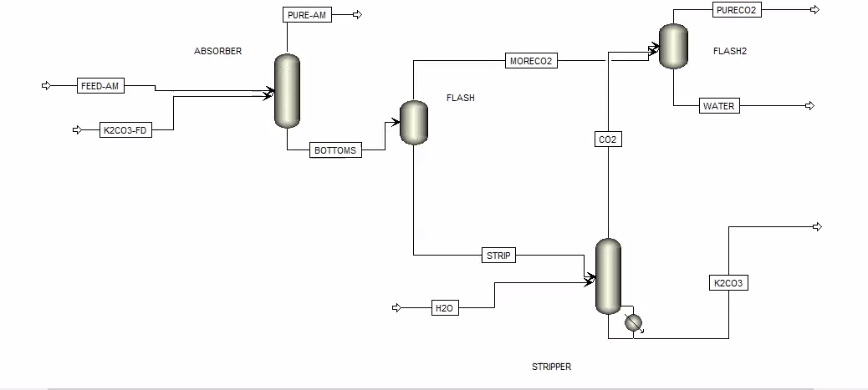

Slide 22
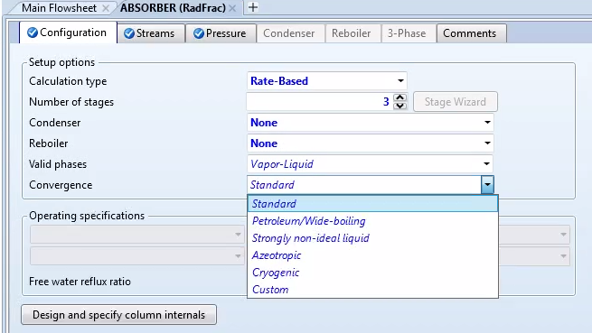
ASPEN Chemical Absorption Column: RADFRAC Setup (8)
Step 1:On the set up page of Radfrac, select Rate-Based.
Step 2: Input the number of stages.
Note: Equilibrium model does not enable determining the options for parameters such as type and amount of packed bed.
Step 3: Select the best convergence based on the 2-phase mixture.

Slide 23
ASPEN Chemical Absorption Column: RADFRAC Setup (9)
Step 1: Under the stream tab, input the feed(s) stage entry location and convention.
Note: The top stage in Aspen Plus is always 1. So the Liquid feed enters above-stage 1. On-stage, enters the other feeds to that specified stage.
Step 2: Input the product stream output stage.

Slide 24
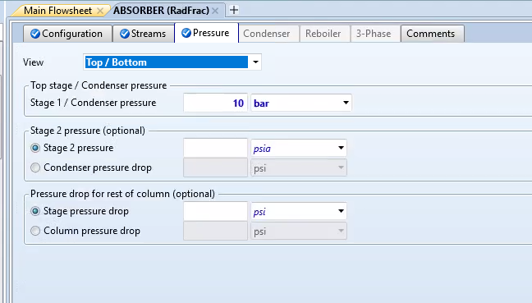
ASPEN Chemical Absorption Column: RADFRAC Setup (10)
Step 1: Under the pressure tab, enter the operating pressure for stage 1.
Pressure drop and other stages pressure, is optional.

Slide 25
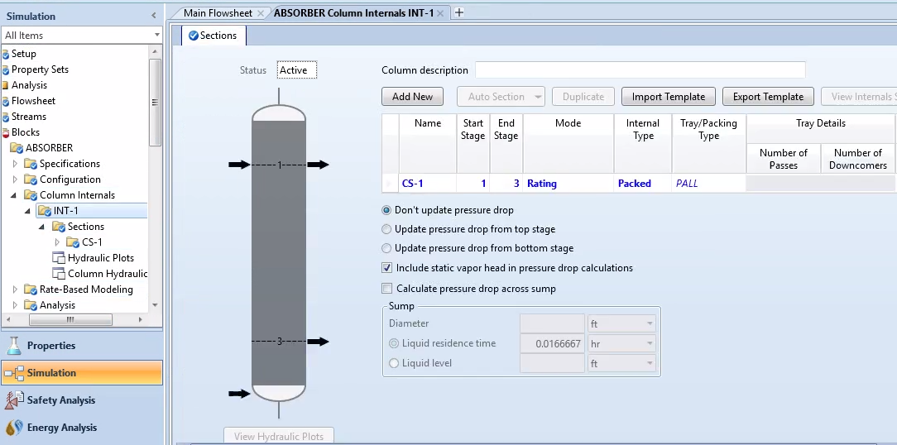
ASPEN Chemical Absorption Column: RADFRAC Setup (11)
Step 1: Under Column internals, define a new (INT-1).
Step 2: Enter the start and end stage of the section, packed height and diameter.
Step 3: Change Mode from default to Rating.
Step 4: Choose the best internal and Packing type for the mixture.

Slide 26
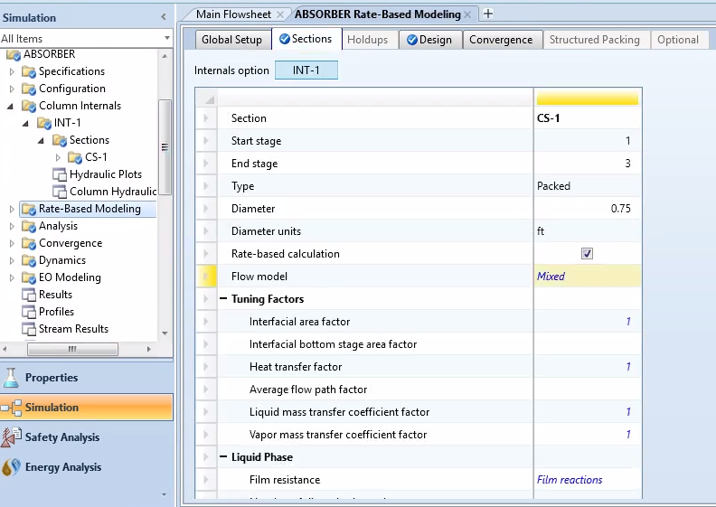
ASPEN Chemical Absorption Column: RADFRAC Setup (12)
Step 1: Under the Rate- based modeling, select rate-based set up.
Step 2: For flow model select mixed, or counter current.
Note: In the mixed flow model, bulk properties for each phase are the same as outlet condition. In the counter-current, the properties of each phase are an average of the inlet and outlet.

